Slide 1

Analysis of a multivariate random variable Workshop 2
Teaching Assistant Irina Deeva, researcher

Slide 2
Key points
Multivariate random variable
Multivariate probability function
Conditional distribution
Correlation analysis​
Dimension reduction
Regression problem
Classification problem

Slide 3
Learning objectives
Students will be able to give examples of a multivariate random variable
Students will be able to evaluate conditional distribution and marginal probability distributions
Students will be able to perform correlation analysis in Python
Students will be able to evaluate the required number of components to reduce the dimension and perform dimension reduction in two ways in Python
Students will be able to solve the regression problem and evaluate the quality of the solution in Python
Students will be able to solve the classification problem and evaluate the quality of the solution in Python

Slide 4
Revising basics
Follow the link https://forms.gle/QAEm3iTQG2WFLFcs6
Fill in the first and last name and then answer the questions
This is an individual work. You have 3 minutes

Slide 5
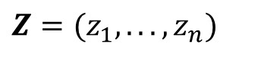
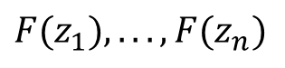
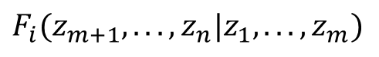
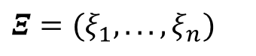

Distribution of Multivariate Random Value
Continuous multivariate random variable (MRV) definition
MRV
Univariate RV
Univariate random outcomes
$$Z=(z_{1},...,z_{n})$$
$$Ξ=(ξ_{1},...,ξ_{n})$$
General definition of multivariate probability function:
$$F_{Ξ}\left(z_{1},...,z_{n}\right)=P\left(ξ_{1}<z_{1},…,ξ_{n}<z_{n}\right)=$$
= $P(ξ_{1}<z_{1})⋅P(ξ_{2}<z_{2}|ξ_{1})⋅…⋅P(ξ_{n}<z_{n}|ξ_{1},…,ξ_{n−1})$
$$F_{i}(z_{m+1},...,z_{n}|z_{1},...,z_{m})$$
Conditional probability functions
$$F(z_{1}),...,F(z_{n})$$
- Unconditional probability functions

Slide 6

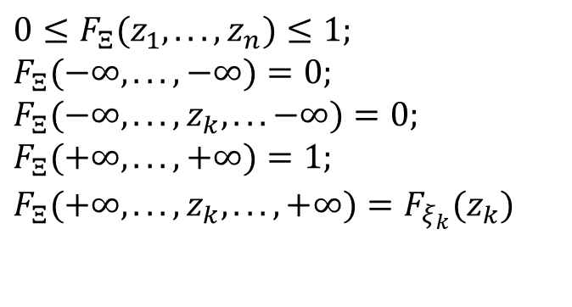
Properties of MRV probability functions
F(x,y) = P{X < x, Y < y}
y
$$0≤F_{Ξ}(z_{1},...,z_{n})≤1; \\ F_{Ξ}(−∞,...,−∞)=0; \\ F_{Ξ}(−∞,...,z_{k},...−∞)=0; \\ F_{Ξ}(+∞,...,+∞)=1; \\ F_{Ξ}(+∞,...,z_{k},...,+∞)=F_{ξ_{k}}(z_{k})$$
(x,y)
(X,Y)
x
All the properties are caused by the general definition of MRV probability function
Generalization for discrete MRV distribution (in terms of distribution laws)
$P_{Ξ}(z_{1},...,z_{n})=P(ξ_{1}=z_{1},…,ξ_{n}=z_{n})=$ $=P(ξ_{1}=z_{1})⋅P(ξ_{2}=z_{2}|ξ_{1})⋅…⋅P(ξ_{n}=z_{n}|ξ_{1},…,ξ_{n−1})$

Slide 7
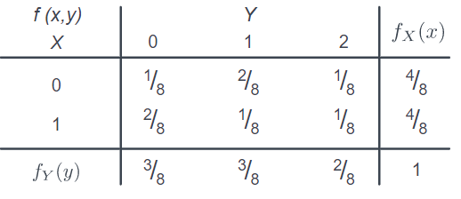
Practice
Let X be a discrete random variable with support S1={0,1}, and let Y be a discrete random variable with support S2={0,1,2}. Suppose, in tabular form, that X and Y have the following joint probability distribution f(x,y):
What is the conditional distribution of X given Y? That is, what is g(x|y)?

Slide 8
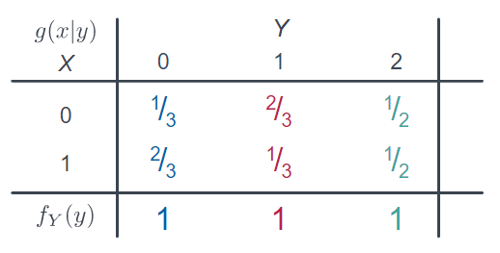
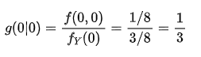
Practice
For example, the 1/3 in the x=0 and y=0 cell comes from:
Using the formula g(x|y)=f(x,y) / fY(y),

Slide 9
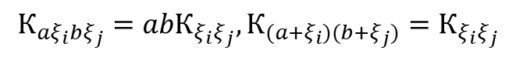
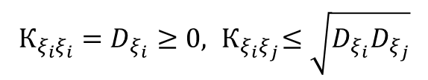
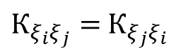
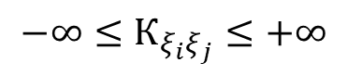
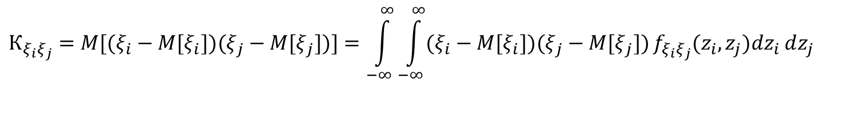
Covariance of MRV
Covariance of MRV is a measure of joint variability of two random variables.
Probabilistic definition of covariance:
$$К_{ξ_{i}ξ_{j}}=M[(ξ_{i}−M[ξ_{i}])(ξ_{j}−M[ξ_{j}])]=\int_{−∞}^{∞}{\int_{−∞}^{∞}{(ξ_{i}−M[ξ_{i}])(ξ_{j}−M[ξ_{j}])}f_{ξ_{i}ξ_{j}}(z_{i},z_{j})dz_{i}}dz_{j}$$
Properties:
$$−∞≤К_{ξ_{i}ξ_{j}}≤+∞$$
The sign of the covariance shows the tendency in the linear statistical relationship between the variables.
Covariance measure is symmetric
$К_{ξ_{i}ξ_{j}}=$ $К_{ξ_{j}ξ_{i}}$
Covariance of URV is equal to it’s variance and always non-negative
$$К_{ξ_{i}ξ_{i}}=D_{ξ_{i}}≥0,{ К}_{ξ_{i}ξ_{j}}≤\sqrt{D_{ξ_{i}}D_{ξ_{j}}}$$
Linearity of covariance allow for useful consequences in a case of linear transformations of RV’s
$$К_{{aξ}_{i}{bξ}_{j}}={abК}_{ξ_{i}ξ_{j}},К_{{(a+ξ}_{i})(b+ξ_{j})}=К_{ξ_{i}ξ_{j}}$$

Slide 10
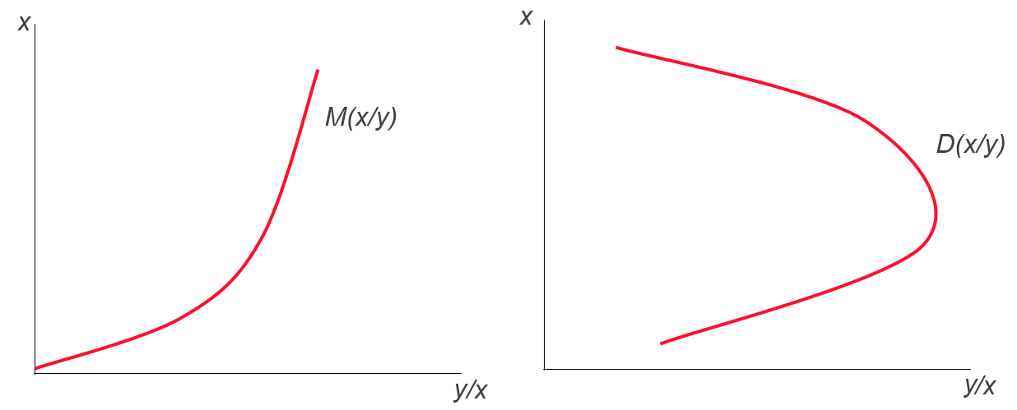
Conditional moments of bivariate RV
Conditional mathematical expectation – regression
Conditional variance – (in Russian – скедастическая кривая)
It can be seen that conditional ME serves as non-parametric regression

Slide 11
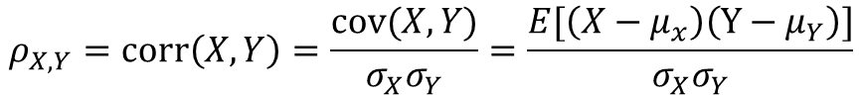
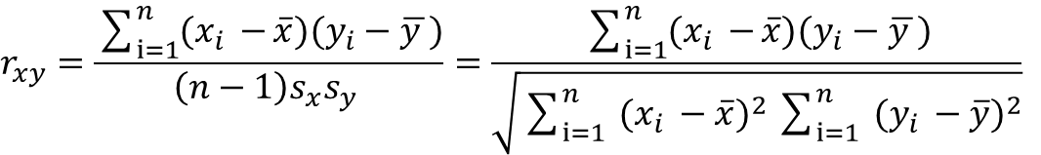
Correlation analysis. Basics
Correlation is a statistical relationship that can show whether and how strong linear dependency between variables is.
Pair coefficient of correlation or Pearson's product-moment coefficient ☺
$$ρ_{X,Y}=corr\left(X,Y\right)=\frac{cov(X,Y)}{σ_{X}σ_{Y}}=\frac{E[\left(X−μ_{x}\right)\left(Y−μ_{Y}\right)]}{σ_{X}σ_{Y}}$$
Estimation of pair coefficient of correlation:
$$r_{xy}=\frac{\sum_{i=1}^{n}{(x_{i }−}\overline{x})(y_{i}−\overline{y })}{\left(n−1\right)s_{x}s_{y} }=\frac{\sum_{i=1}^{n}{(x_{i }−}\overline{x})(y_{i}−\overline{y })}{\sqrt{\sum_{i=1}^{n}{ {(x_{i }−\overline{x})}^{2}}\sum_{i=1}^{n}{ {(y_{i }−\overline{y})}^{2}}}}$$

Slide 12
Confidence interval and significance level
Correlation property:
If
then
Significance level:
Fisher transformation:
- Normally distributed values z
Practically, it could be assumed that r estimation is unbiased
Confidence interval for ρ:
Student distribution

Slide 13
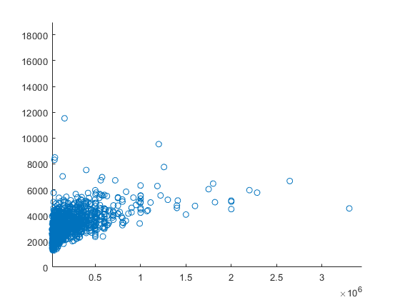
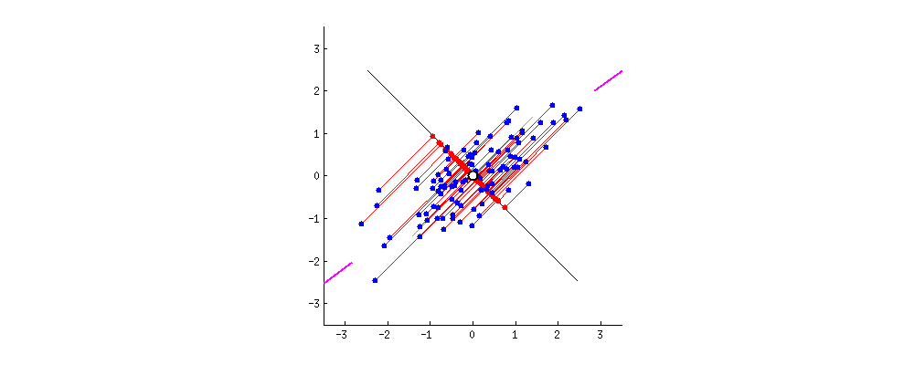
Principal component analysis
Principal component analysis is used to reduce the dimension of data while preserving as much information as possible (in terms of variance).
An illustration of choosing a new axis with the least sum of squares of distances to it:
Geometric interpretation
Main component 1
Dmax
X1
Example: reducing dimensionality transactional data.
https://leonardoaraujosantos.gitbooks.io/artificial-inteligence/
X2

Slide 14
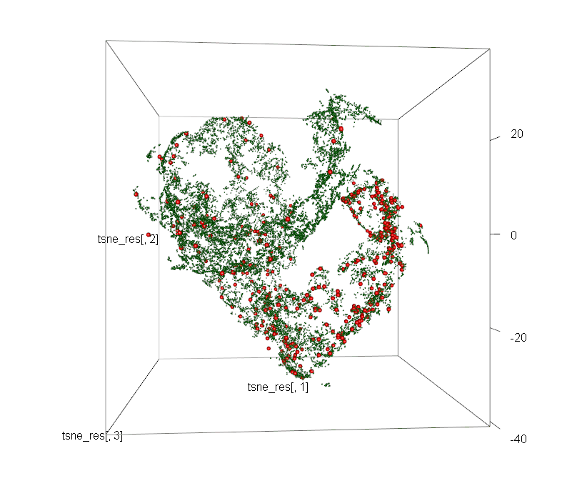
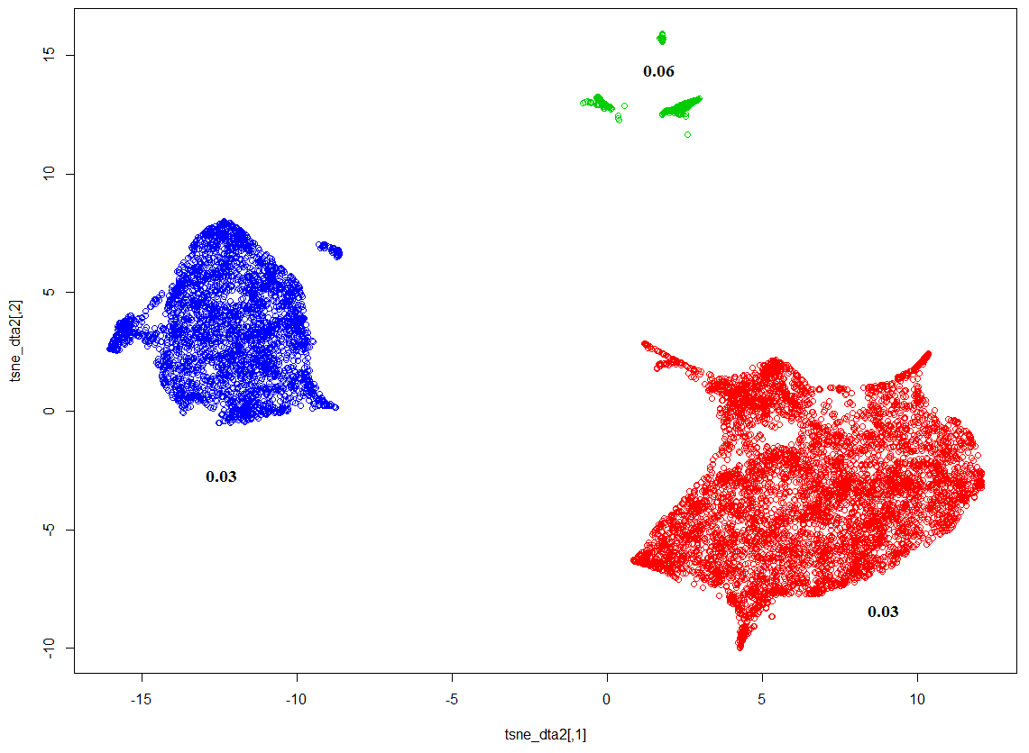
tSNE
t-SNE – (t-distributed stochastic neighbor embedding) – nonlinear dimensionality reduction algorithm.
Idea: the "similarity" (in the form of conditional distributions) of the points of the source and target (2D or 3D) spaces is estimated on each other, and then the similarity of these distributions is estimated, and the minimum is found.
Cluster “Low spending and no credit history”
The share of “bad” - 6%
First Credit Cluster
The share of “bad” - 3%
Example: Analysis of borrowersInput: 50 transaction profile parametersResult: 2D or 3D representation of compressed objects and the position of “bad” borrowers (red dots).
Cluster “Borrowers with a credit history”
The share of “bad” - 3%

Slide 15
Example in Python
Open file Multivariate Analysis Data into Python.ipynb https://drive.google.com/drive/folders/1mps-_1bN0FckoKbvBi1DI85LElVdVGVu?usp=sharing
Follow teacher instructions and run parts of the program code with me

Slide 16
Example in Python
Open file Task2.ipynb https://drive.google.com/drive/folders/1mps-_1bN0FckoKbvBi1DI85LElVdVGVu?usp=sharing
Follow teacher instructions and run parts of the program code with me

Slide 17
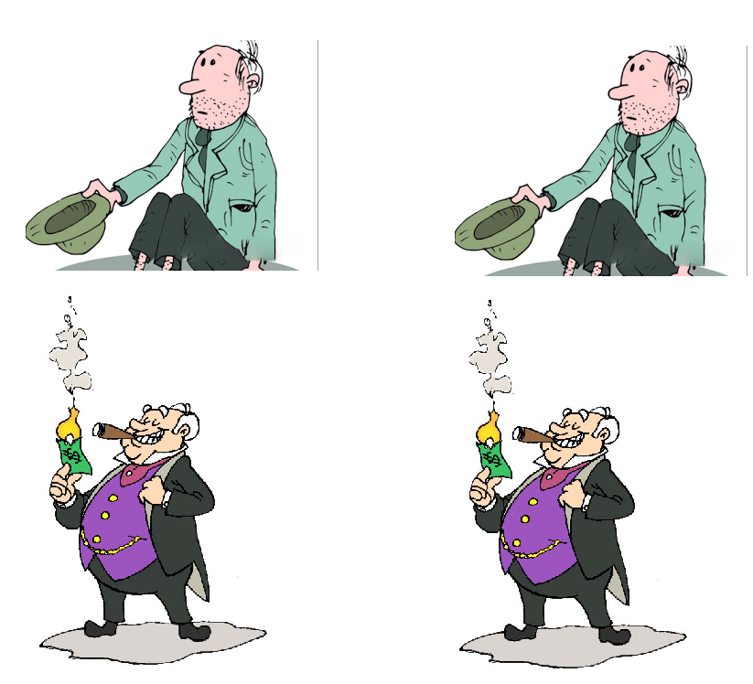


Type 1 and 2 errors
Hypothesis -
0
Hypothesis - 1
Type 1 error:
True negative
False
positive
In fact - 0
(Negative)
In fact - 1
(Positive)
True positive
False negative
Type 2 error:
​

Slide 18
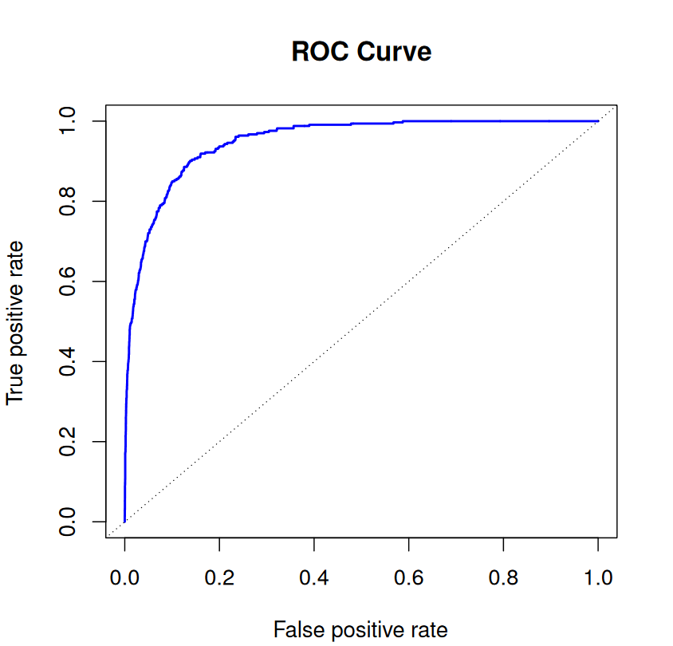
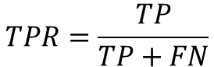
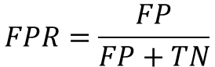
Assessment of the classifier model quality
AUC-ROC (or ROC AUC) — Area Under Curve or Receiver Operating Characteristic under "curve". This curve is a line from (0,0) to (1,1) in coordinates of True Positive Rate (TPR) and False Positive Rate (FPR):
$$TPR=\frac{TP}{TP+FN}$$
In ideal case, when classifier doesn't make errors, (FPR = 0, TPR = 1)
$$FPR=\frac{FP}{FP+TN}$$

Slide 19
Example in Python
Open file Regression.ipynb https://drive.google.com/drive/folders/1mps-_1bN0FckoKbvBi1DI85LElVdVGVu?usp=sharing
Follow teacher instructions and run parts of the program code with me

Slide 20
Example in Python
Open file Classification_for_Bank_Marketing_Dataset.ipynb https://drive.google.com/drive/folders/1mps-_1bN0FckoKbvBi1DI85LElVdVGVu?usp=sharing
Follow teacher instructions and run parts of the program code with me

